Slide 1
Pointers and Arrays
Subject : COMP6047
ALGORITHM AND PROGRAMMING
Year : 2019

Slide 2
Learning Outcomes
At the end of this session, student will be able to:
Explain the concept of array data and pointer
(LO2 & LO3)

Slide 3
Sub Topics
Pointers and Arrays:
Pointer Definition
Pointer Concept
Pointer to Pointer
Array Definition
Array Initialization
Pointer Constant & Pointer Variable
Accessing Array
2 and 3 Dimensional Array
Program Examples
Exercise
Review

Slide 4
Pointer Definition
Pointer is a variable that store the address of another variable
Syntax :
<type> *ptr_name;
Two operators mostly used in pointer : * (content of) and & (address of)
Example:
Initialize an integer pointer into a data variable:
int i, *ptr;
ptr = &i;
To assign a new value to the variable pointed by the pointer:
*ptr = 5; /* means i=5 */

Slide 5
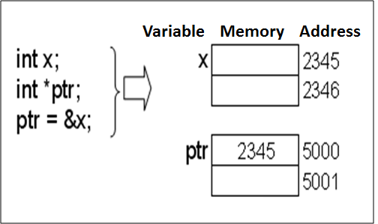
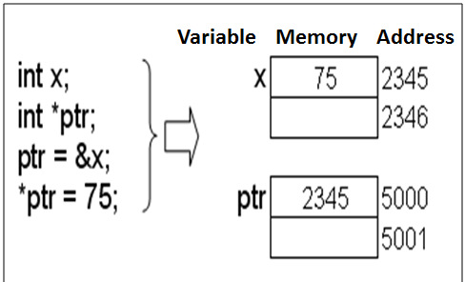
Pointer Concept

Slide 6
Pointer to Pointer
Pointer to pointer is a variable that saves another address of a pointer
Syntax:
<type> **ptr_ptr ;
Example:
int i, *ptr, **ptr_ptr;
ptr = &i;
ptr_ptr = &ptr;
To assign new value to i:
*ptr = 5; // means i=5 ;
**ptr_ptr = 9; // means i=9; or *ptr=9;

Slide 7
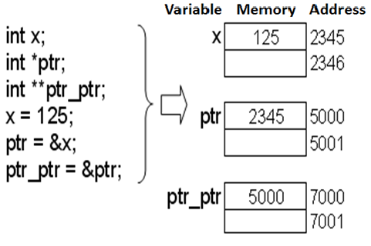
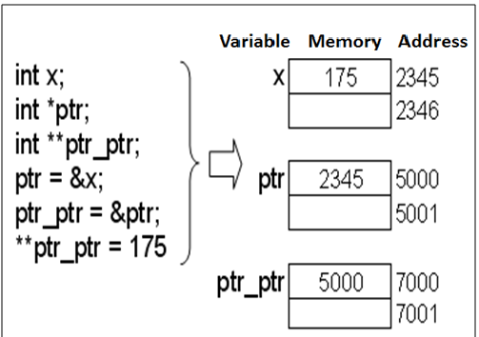
Pointer to Pointer

Slide 8
Array Definition
Data saved in a certain structure to be accessed as a group or individually. Some variables saved using the same name distinguish by their index.
Array characteristics:
Homogenous
All elements have similar data type
Random Access
Each element can be reached individually, does not have to be sequential

Slide 9
Array Definition (One Dimensional Array)
Syntax:
type array_value [value_dim];
Example :
int A[10];
The definition consists of 4 components:
Type specified
Identifier (name of the array)
Operator index ([ ])
Dimensional value inside operator [ ]

Slide 10
Array Definition
An illustration of array 1D
Elements of an array indexed starting from 0
A[0]
A[1]
A[2]
A[3]
A[4]
A[5]
A[6]
A[7]
A[8]
A[9]

Slide 11

Array Initialization
Array can be initialized explicitly without dimensional value declaration
Example:
int B[ ]={1, 2, -4, 8};
Array B has 4 elements
Example:
int B[8]={1, 2, -4, 8};

Slide 12
Array Initialization
Example: int B[4] = { 1, 2, -4, 8, 9 }; //error
error in result; smaller dimensional value
Example array initialization after definition:
int A[5];
(for i=0; i<5;i++) A[i]=0;
int B[5];
B[5]={0,0,0,0,0};
Error, why ?

Slide 13
Accessing Arrays
Two analogous ways of accessing an element i=2;
*(A+2) or A[2]
A is equivalent with &A[0] or a constant pointer to the first element of particular array
To show A[2] on the monitor screen:
printf(“%d”,A[2]) or
printf(“%d\n”,*(A+2));

Slide 14
Assigning Values
Assigning value to an element
Example : A[6] = 15; A[3] = 27;
Statement A[2] = A[3] - A[6], resulting:
27
15
A[0]
A[1]
A[2]
A[3]
A[4]
A[5]
A[6]
A[7]
A[8]
A[9]
12
27
15
A[0]
A[1]
A[2]
A[3]
A[4]
A[5]
A[6]
A[7]
A[8]
A[9]

Slide 15
Pointer Constant & Pointer Variable
Pointer variable is a pointer that can be assigned with new value at run-time.
Pointer constant is a pointer that can not be assigned with new value at run-time
Array is Pointer Constant to its first element of the array. Array can be filled with pointer variable.
Example:
int x=10, y=20;
int *ptr; //ptr is pointer variable
ptr = &x;
ptr = &y;

Slide 16
Pointer Constant & Pointer Variable
Example:
int x=10, y=20;
int B[4]; // B is an Array → pointer constant
int *ptr; // ptr is a pointer variable
ptr = &x; // ok
ptr = B; // ok
ptr++; // ok
B = ptr; // error
B++; // error
B = &y; // error
ptr = B; analogous with ptr = &B[0]; B is a pointer constant pointing to the first element of an array.

Slide 17
Pointer Constant & Pointer Variable
Pointer constant can only be initialized at definition time
Example:
int Arr1[10];
Arr1[10] = {1, 2, 3, 4, 5}; // error
Arr1 = {1, 2, 3, 4, 5}; // error
Arr1[10] = 12; // error max 9
Arr1[0] = 23; // ok
int Arr2[10] = {1, 2, 3, 4, 5}; //ok

Slide 18
Accessing Arrays
Accessing array using a pointer
int arr[10];
int *ptr_arr;
ptr_arr = arr; //or ptr_arr = &arr[0];
To access certain element can be done using:
ptr_arr[i];
arr[i];
*(ptr_arr + i);
*(arr + i);
ptr_arr = ptr_arr + i; *ptr_arr;

Slide 19
Array: Program Examples
Example:
#include <stdio.h>
void main()
{
int i;
int list_int[10];
for (i=0; i<10; i++){
list_int[i] = i + 1;
printf( "list_int[%d] init with %d.\n", i, list_int[i]);
}
}

Slide 20
One Dimensional Array
C compiler does not limit number of dimensional which can be created. Our PC memory does.
Example Array 1D:
#include<stdio.h>
int SIZE = 5;
void main() {
int i, j;
int n[SIZE] = {15, 9, 1, 7, 5};
for( i=0 ; i<= SIZE ; i++) {
printf("%5d ", n[i]);
for ( j=1; j<=n[i] ; j++) printf("%c","*");
printf("\n");
}
}

Slide 21
Two Dimensional Array
Syntax 2D Array:
type name_array[row][col];
Example:
int a[3][4];
Column 0
Column 1
Column 2
Column 3
Row 0
a[ 0 ][ 0 ]
a[ 0 ][ 1 ]
a[ 0 ][ 2 ]
a[ 0 ][ 3 ]
Row 1
a[ 1 ][ 0 ]
a[ 1 ][ 1 ]
a[ 1 ][ 2 ]
a[ 1 ][ 3 ]
Row 2
a[ 2 ][ 0 ]
a[ 2 ][ 1 ]
a[ 2 ][ 2 ]
a[ 2 ][ 3 ]
Column subscript
Array name
Row subscript

Slide 22
Two Dimensional Array
Initialization:
using rmo (row major order)
Example:
int b[2][2] = {1, 2, 3, 4 };
int b[2][2] = { { 1, 2 }, { 3, 4 } };
int b[2][2] = { { 1 }, { 3, 4 } };
int x[3][4] = {1, 2, 3, 4, 5, 6, 7, 8, 9, 10, 11, 12};
int x[3][4] = { {1, 2, 3, 4},
{5, 6, 7, 8},
{9, 10, 11, 12}
};
1 2
3 4
1 0
3 4

Slide 23
Two Dimensional Array
Example Array 2D:
/* Printing out array 2-D */
#include <stdio.h>
void main() {
int two_dim[3][5] = {1, 2, 3, 4, 5,
10, 20, 30, 40, 50,
100, 200, 300, 400, 500};
int i, j;
for (i=0; i<3; i++){
for (j=0; j<5; j++) printf("%6d", two_dim[i][j]);
printf("\n");
}
}
Output:
1 2 3 4 5
10 20 30 40 50
100 200 300 400 500

Slide 24
Three Dimensional Array
Syntax 3D Array :
type name_array[row][col][depth];
Example:
int x[3][2][4] = {{{1,2,3,4}, {5,6,7,8}},
{{11,12,13,14}, {15,16,17,18}},
{{21,22,23,24}, {25,26,27,28}}
};
void main() {
int x[4][3][5] = {{{1, 2, 3}, {0, 4, 3, 4}, {1, 2}},
{{9, 7, 5}, {5, 7, 2}, {9}},
{{3, 3, 5}, {2, 8, 9, 9}, {1, 2, 1}},
{{0}, {1}, {0, 1, 9}}
};
printf(“%5d”, x[2][1][3]);
}

Slide 25
Exercise
Create a program to get 10 integer values from keyboard and store in an array. Find out:
Max value inside the array
Min value inside the array
Calculate average value of the array
Show the result to the monitor
Create a program in C to:
Get a string from keyboard
Rotate those characters
Display the result
Example: input : KASUR
rotated : RUSAK

Slide 26
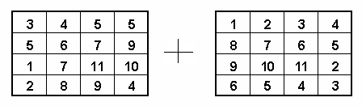
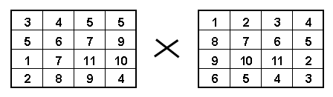
Exercise
Create a program of matrix addition. Use 2D array!
Create a program of matrix multiplication. Use 2D array!

Slide 27
Exercise
Given the following Arrays:
int A[3][4]={1, 3, 2, 4, 5, 7, 6, 8, 9,11, 12 };
int B[3][3]={{1, 2}, {3, 4, 5} ,{ 7 }};
What are the values of:
A[1][1] = ?
B[2][2] = ?
A[2][3] = ?
B[0][1] = ?
A[0][2] = ?

Slide 28
Summary
Pointer is a variable that store the address of another variable
Pointer to pointer is a variable that saves another address of a pointer
Data saved in a certain structure to be accessed as a group or individually. Some variables saved using the same name distinguish by their index which called as an array

Slide 29
References
Paul Deitel & Harvey Deitel. (2016). C how to program : with an introduction to C++. 08. Pearson Education. Hoboken. ISBN: 9780133976892. Chapter 6 & 7
C Programming – Pointers: http://www.exforsys.com/tutorials/c-language/c-pointers.html
Storing Similar Data Items: http://aelinik.free.fr/c/ch12.htm

Slide 30
END

